Slide 1
Water Treatment
Dr. Mukul Maheshwari

Slide 2
Introduction
Definition: Water treatment is the process of making water suitable for specific uses, such as drinking, industrial applications, or environmental health.
Importance: Critical for safe drinking water, sanitation, and environmental protection.
Overview of Process: Common stages include coagulation, sedimentation, filtration, and disinfection

Slide 3
Objectives
Safe Consumption: Removing harmful contaminants for safe drinking water.
Environmental Protection: Reducing pollution in water bodies.
Industrial Needs: Producing water for agriculture, power generation, and manufacturing.

Slide 4
Common Contaminants in Water Sources
Physical Contaminants: Sediment, dirt, debris.
Chemical Contaminants: Heavy metals, pesticides, pharmaceuticals.
Biological Contaminants: Bacteria, viruses, and protozoa.Significance: Understanding contaminants guides appropriate treatment techniques.

Slide 5
Primary Stages of Water Treatment
Overview of Key Stages: Coagulation and Flocculation: Chemicals added to bind particles.
Sedimentation: Allowing particles to settle naturally.
Filtration: Removing suspended particles by passing water through filters.
Disinfection: Using chemicals or UV light to eliminate pathogens.
Solar Water Disinfection

Slide 6
Coagulation and Flocculation
Process: Adding coagulants (e.g., alum) to clump small particles into larger flocs.
Importance: Essential first step to reduce turbidity and prepare water for further filtration.
Factors Affecting Efficiency: pH, temperature, and type of coagulant.

Slide 7
Sedimentation
Principle: Allows flocs to settle at the bottom due to gravity.
Sedimentation Tanks: Typically designed with inclined plates to maximize efficiency.
Benefits: Reduces the load on filters, thus improving the efficiency and longevity of downstream processes.

Slide 8
Sand Filtration
Purpose: Sand filtration removes particles and pathogens from water using layers of sand and gravel.
Common Use: Effective for removing suspended solids, turbidity, and some pathogens.
Two Types: Slow Sand Filtration (SSF) and Rapid Sand Filtration (RSF).

Slide 9
Slow Sand Filtration (SSF)
Process Description:Water passes slowly through layers of fine sand and gravel.
A biological layer, known as schmutzdecke, forms on top of the sand and helps in microbial degradation.
Key Features:
Flow Rate: Typically 0.1 - 0.4 m³/m²/hour (very slow).
Filtration Layer: 0.5–1.5 meters of sand.
Maintenance: Requires periodic scraping of the schmutzdecke layer.

Slide 10
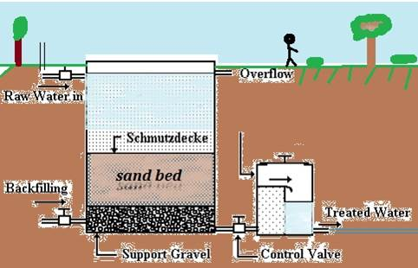
Advantages: Effective at removing bacteria, protozoa, and some viruses.
Simple, low-cost, and sustainable for small communities.
Disadvantages: Requires significant area and maintenance.
Not effective for high-turbidity water.

Slide 11
Rapid Sand Filtration (RSF)
Process Description: Water flows quickly through coarser sand and gravel.
Requires regular backwashing to clean the sand and remove trapped particles.
Key Features:
Flow Rate: 5 - 15 m³/m²/hour (much faster than SSF).
Filtration Layer: 0.5–1.5 meters of coarser sand.
Backwashing: Frequent backwashing to clear clogged particles.

Slide 12
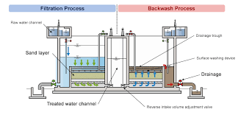
Advantages:
Suitable for high-volume water treatment.
Requires less land area and operates quickly.
Disadvantages:
Higher operational costs due to backwashing.
Less effective than SSF for pathogen removal; often combined with chlorination.

Slide 13
Filtration Techniques
Types of Filtration: Sand Filtration: Effective for removing suspended solids.
Activated Carbon: Absorbs organic contaminants, improving taste and odour.
Membrane Filtration (e.g., reverse osmosis): Used for fine filtration and desalination.
Application: Choosing the right filtration method based on water quality and intended use.

Slide 14
Disinfection
Purpose: Final stage to eliminate microbial contaminants.
Methods:Chlorination: Effective and widely used, but can produce by-products.
UV Radiation: Kills bacteria and viruses without chemicals.
Ozonation: Powerful, though costly, and leaves no residual taste.
Considerations: Each method’s effectiveness depends on water quality and micrombial load.

Slide 15
Advanced Water Treatment Techniques
Reverse Osmosis: Removes dissolved salts and impurities; commonly used in desalination.
Ion Exchange: Effective for softening water and removing heavy metals.
Advanced Oxidation Processes (AOPs): Break down organic pollutants using UV, ozone, or peroxide.
Applications: Suitable for industrial wastewater, reclaimed water, and other high-quality needs.

Slide 16
Biological Water Treatment
Activated Sludge Process: Uses microorganisms to decompose organic matter.
Constructed Wetlands: Eco-friendly, using plants to filter water naturally.
Advantages: Sustainable, cost-effective, and beneficial for nutrient removal.

Slide 17
Water Quality Testing and Standards
Key Parameters: pH, turbidity, microbial count, chemical content.
Testing Methods: Laboratory tests vs. field testing kits.
Regulatory Standards: Overview of WHO and EPA standards for safe water.

Slide 18
Water Treatment Challenges and Solutions
Challenges: Complex pollutants requiring specialised treatment.
Infrastructure and cost limitations.
Solutions: Innovative technologies for contaminant-specific treatment.
Emphasis on sustainable practices and resource conservation.

Slide 19
Case Study: Effective Water Treatment Systems Case
Example: Singapore’s NEWater system for reclaimed water.
Lessons Learned: Importance of advanced treatment, community trust, and ongoing research.
Application: Highlight how similar systems can be adapted globally for water sustainability.

Slide 20
Conclusion
Summary: Water treatment ensures health, safety, and environmental sustainability.
Future Trends: Growth in sustainable and energy-efficient treatment methods.
Key Takeaway: Clean water access is a fundamental need requiring continuous innovation and commitment.

